Slide 1

Citywide effects of high-occupancy vehicle restrictions: Evidence from “three-in-one” in Jakarta
by Rema Hanna, Gabriel Kreindler, and Benjamin A. Olken
Science
Volume 357(6346):89-93
July 7, 2017
Published by AAAS

Slide 2
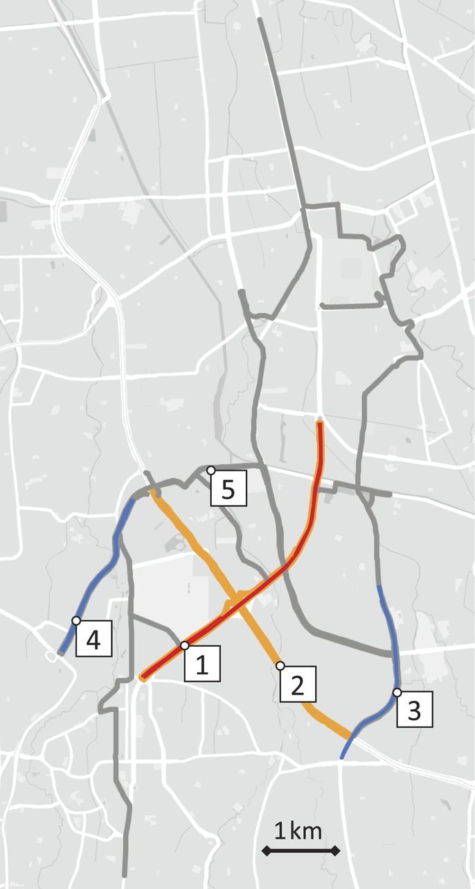
Fig. 1 Routes included in the analysis.
Rema Hanna et al. Science 2017;357:89-93
Published by AAAS
Notes:
Routes included in the analysis. (1) Former three-in-one road (Jalan Sudirman, red and orange). (2) Former three-in-one road (Jalan Gatot Subroto, orange). (3) Unrestricted alternate road (Jalan Rasuna Said, blue). (4) Unrestricted alternate road (Jalan Tentara Pelajar, blue). (5) Eight unrestricted alternate routes from the Jakarta Department of Transport (gray). Routes from the first phase of data collection are drawn with thin lines: 1 (red), 3 (blue), and 4 (blue). [Map data from Google, 2017]

Slide 3
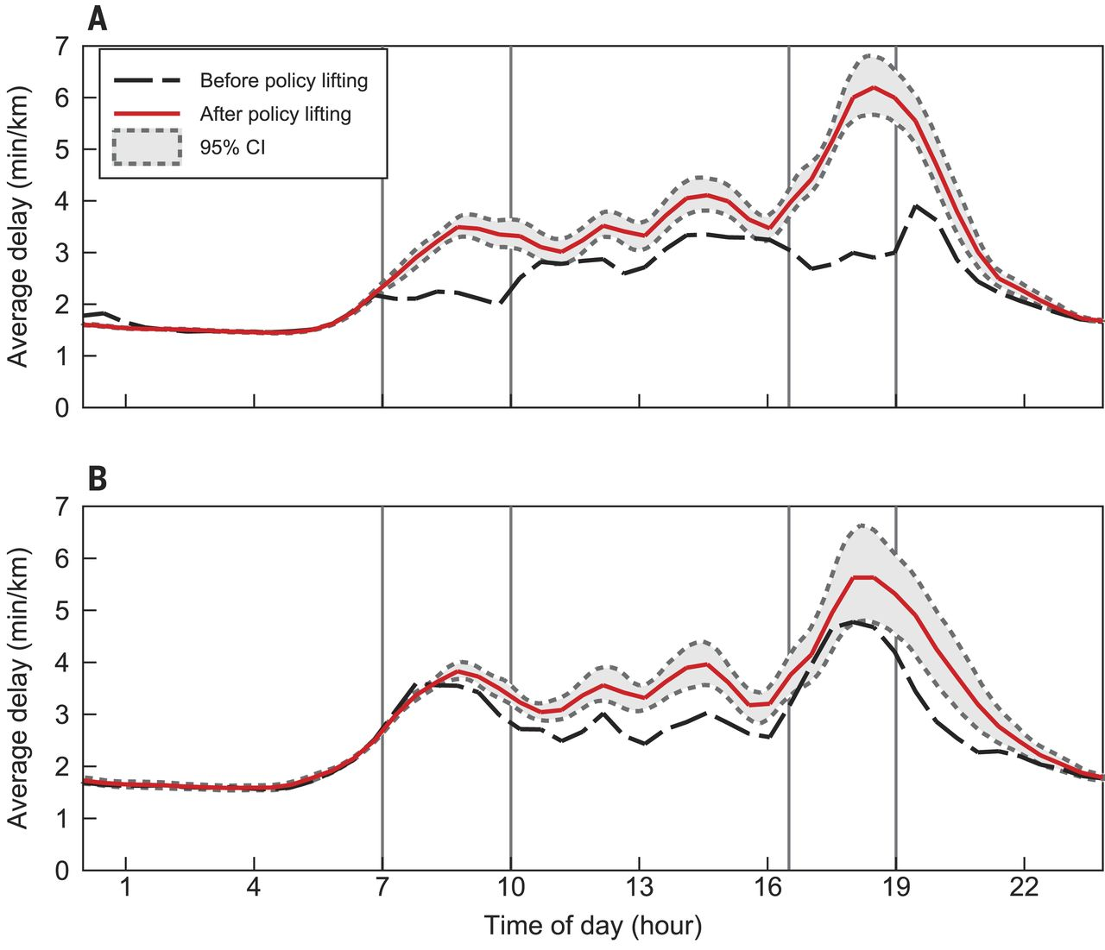
Fig. 2 Effect of three-in-one policy-lifting.
Rema Hanna et al. Science 2017;357:89-93
Published by AAAS
Notes:
Effect of three-in-one policy-lifting. (A) Former three-in-one restricted road (Jalan Sudirman) and (B) unrestricted alternate road (Jalan Rasuna Said). The graphs show locally linear regressions (Epanechnikov kernel, 0.2-hour bandwidth) of delay on departure time, before and after the lifting. Uses “live” data pre- and post-lifting. Predata are from Thursday 31 March (4:40 p.m. onward), Friday 1 April, and Monday 4 April. Postdata are from all weekdays 5 April to 4 May. For each departure time, there are two observations per route, corresponding to the two road directions. Pointwise bootstrapped 95% confidence bands around postdata, adjusted for date times road direction clusters (1000 bootstrap iterations).

Slide 4
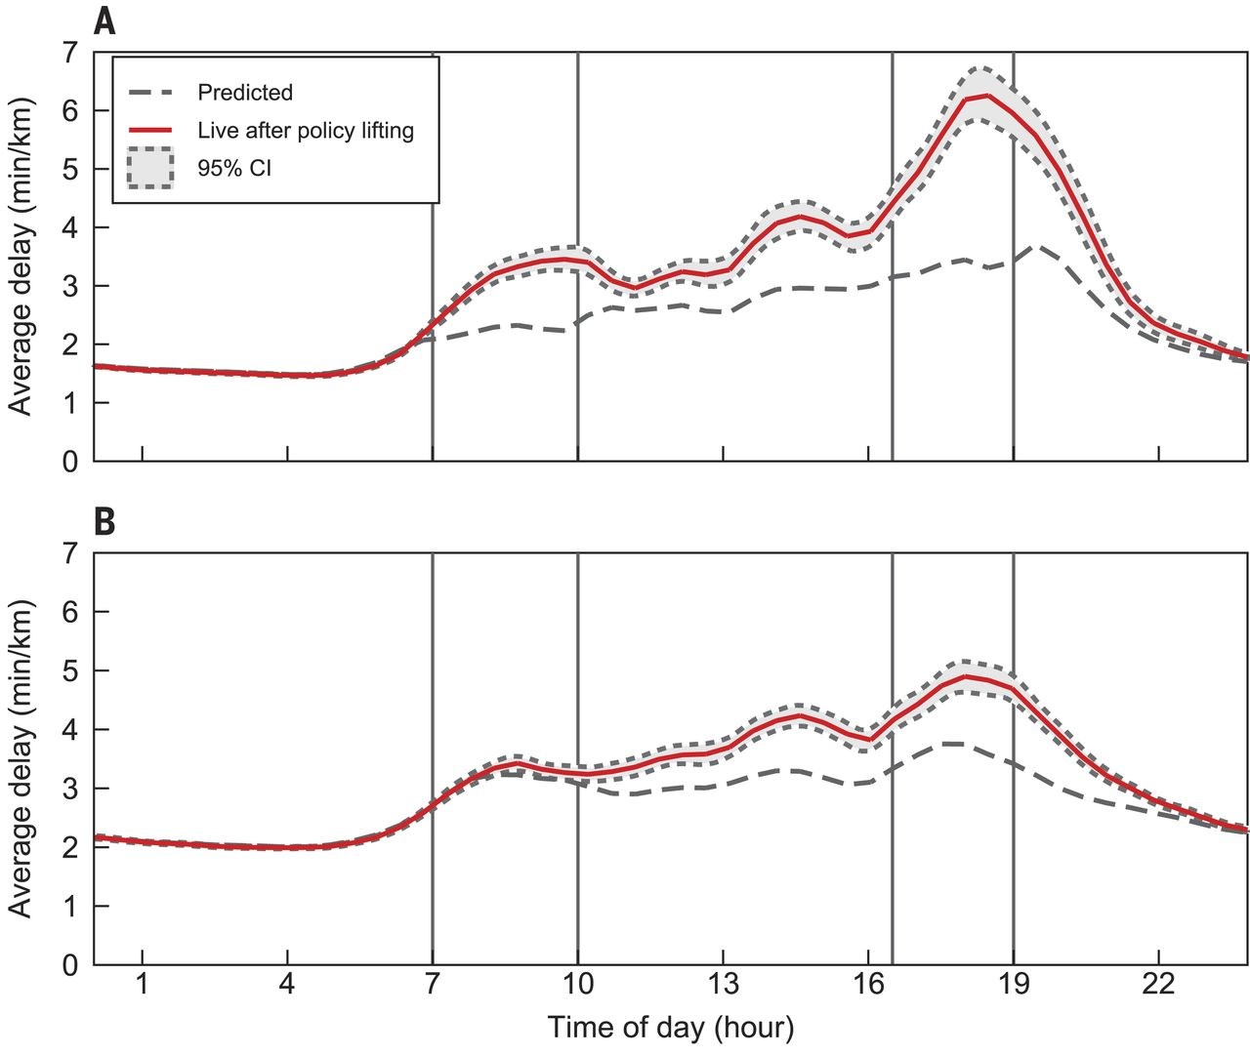
Fig. 3 Effect of three-in-one policy-lifting on expanded set of routes using “predicted” counterfactual.
Rema Hanna et al. Science 2017;357:89-93
Published by AAAS
Notes:
Effect of three-in-one policy-lifting on expanded set of routes using “predicted” counterfactual. (A) Both former three-in-one restricted roads (Jalan Sudirman and Jalan Gatot Subroto) and (B) eight unrestricted alternate routes (identified by Jakarta Department of Transportation). Postdata from all weekdays 28 April to 3 June. See Fig. 2 for further information.

